Slide 1
Hotel Accomodation -Operational Manager
Presentation by
Vagelis Chasiotis
Filippos Symeonidis

Slide 2
Objectives
Introduction & User Story
Analysis & Objectives
Design & Entity-Relationship Diagram (EDR)
Development Tools
User Interface - Dashboard
Results
Future Developments
Practicum Key Learnings & Future Goals
Questions session
Table of Contents

Slide 3
As a manager in the hotel group, I want to be able to view all of our hotels along side with their information and be able to monitor their room power consumption in comparison to all of the other expenses.
User Story

Slide 4
Our analysis is divided into 3 major points:
Accommodation Type & Attributes (Entity Models & Instances)
Data Gathering, Storing, and Transformation (IoT App)
Design and Display the Data (Dashboard Builder)
Analysis/Entity Model
Hotel
Rooms / Suites
Smart Device

Slide 5
Data Collection and Analysis
Expected KPIs
Optimize Hotel Operations
Reduce Unnecessary Expenses
Improve Customer Satisfaction

Slide 6
Design Process
Our design follows 3 steps:
Design the Hotel and Room entity models
Design the patterns (logical flows) in the IoT App
Design the Dashboard (presentation layer)
Design Approach

Slide 7
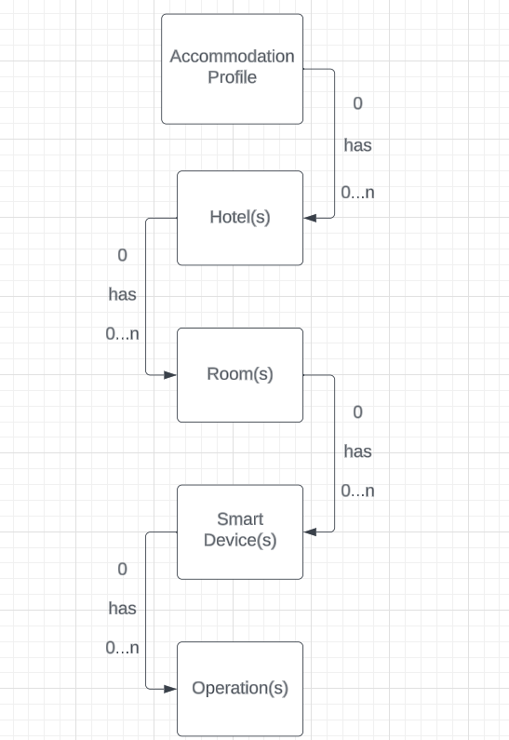
ERD - Model
ERD- Model

Slide 8
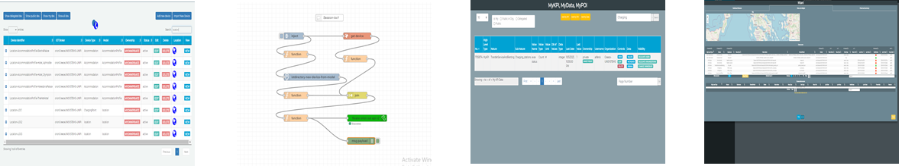
Development Tools
Smart IoT
Directory
Smart IoT
App
MyKPI
Dashboard Builder
Used to register new IoT Models and Devices
Used to manage IoT devices (metadata, ownership, broker)
Visual Programming Tool (Node-RED) for the platform
Used to collect, manage, and visualize KPIs (Key Performance Indicators)
Used to create and manage the Dashboard

Slide 9
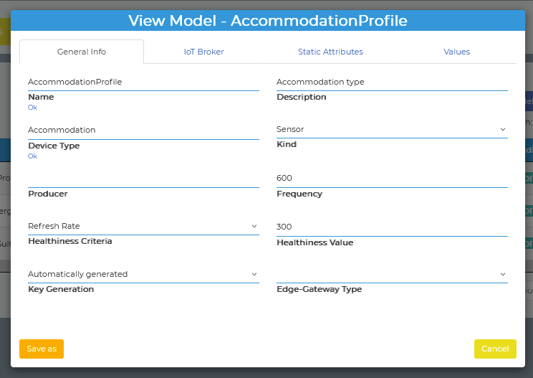
Initialization of Devices
IoT Directory (Accommodation Profile)

Slide 10
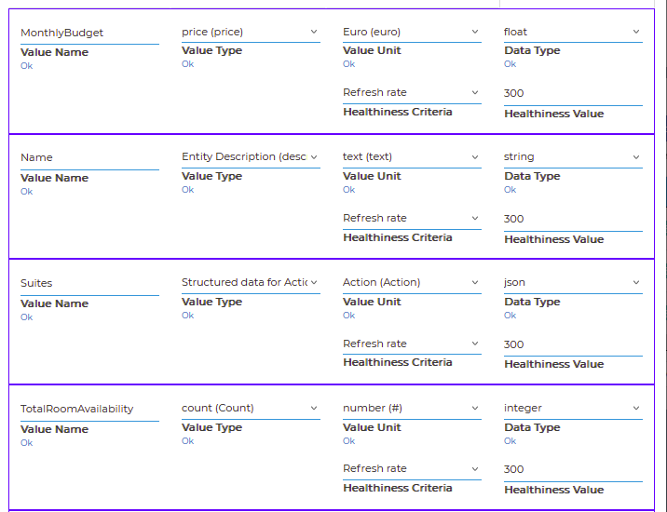
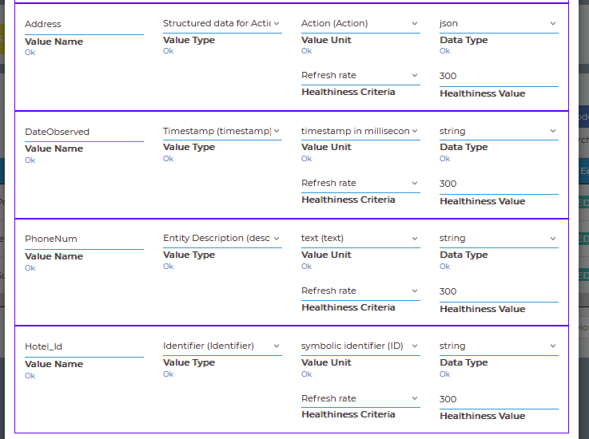
Initialization of Devices
IoT Directory (Accommodation Profile)

Slide 11
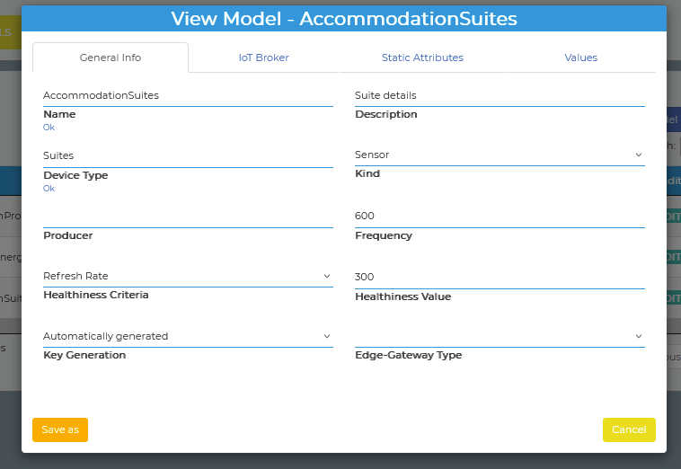
Initialization of Devices
IoT Directory (Αccomodation Suites)

Slide 12
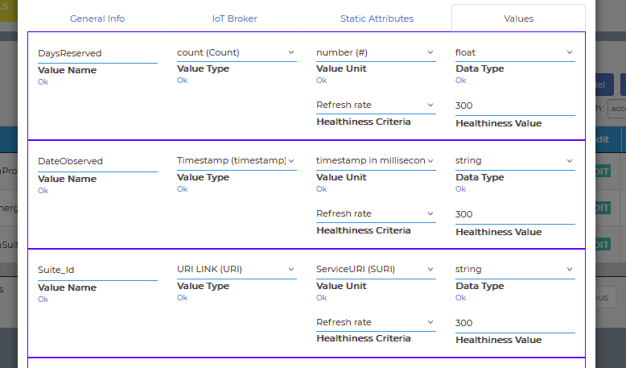
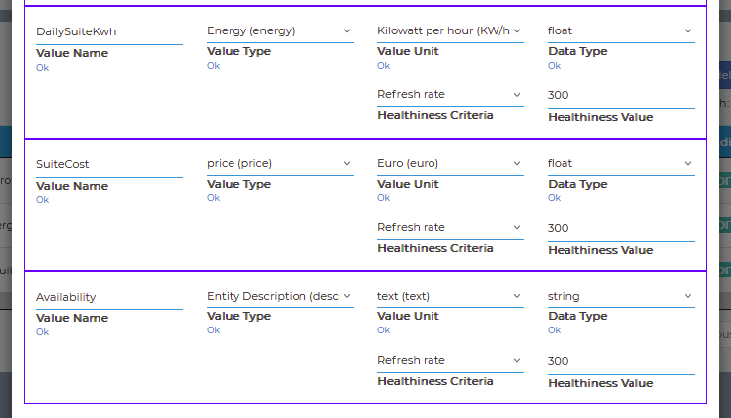
Initialization of Devices
Attributes/Values

Slide 13
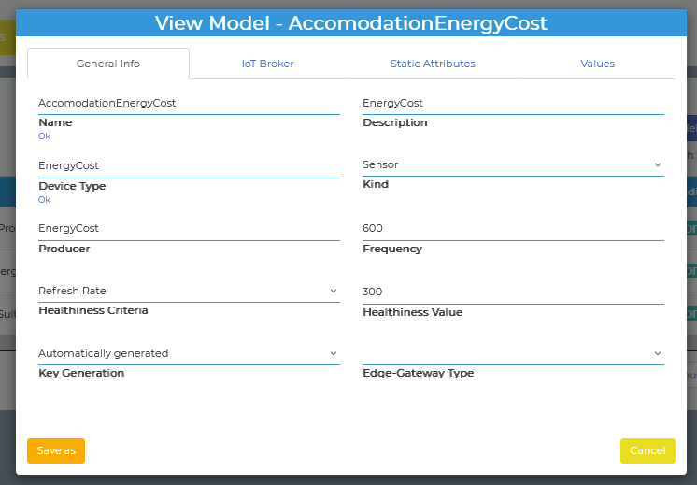
Initialization of Devices
Configuration Device

Slide 14
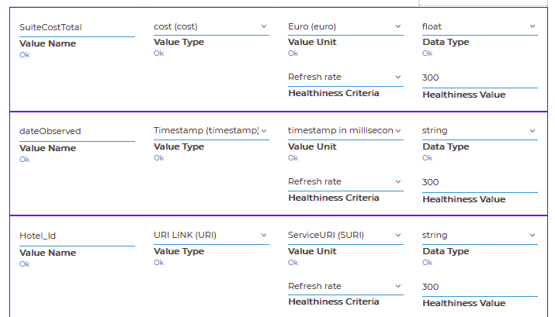
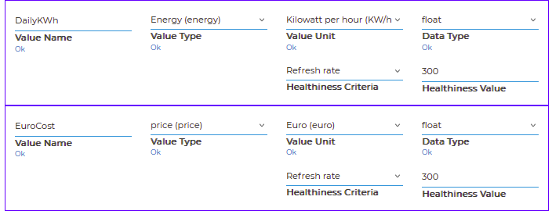
Initialization of Devices
Attributes/Values

Slide 15
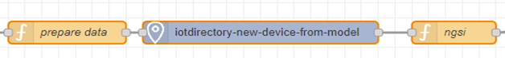
Initialization of Devices
Dynamic Entity Instances: On Iot Device Application
Service URI is private
Logical Flow (NGSI Standard)

Slide 16
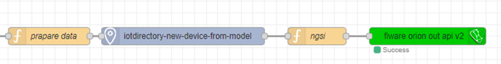
Initialization of Broker
Internal brokers used to manage all aspects of the device lifecycle such as:
●Registration
●Configuration
●Data Management
Logical Flow (FIWARE Node)

Slide 17
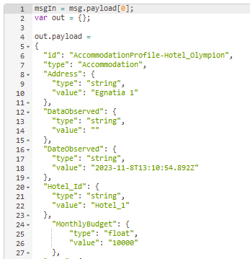
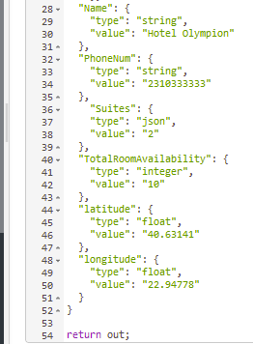
Data Input
Values for our hotels
JSON Payload

Slide 18
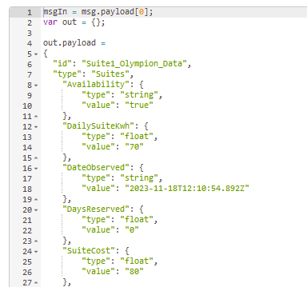
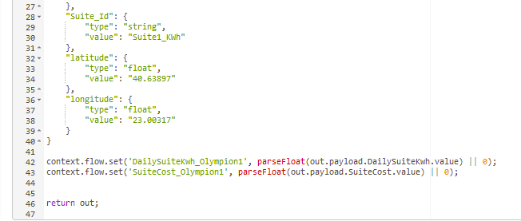
Data Input
Information for the hotel suites
At the bottom we store the cost and KWh values for the total
JSON Payload –Hotel Suites

Slide 19
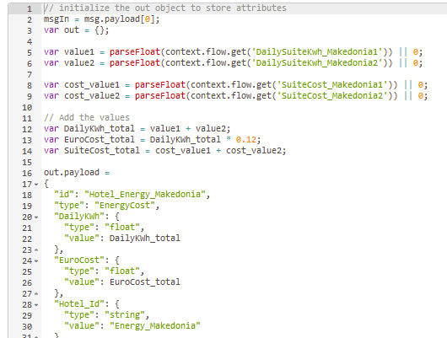
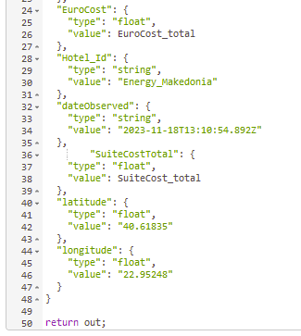
Data Manipulation
From the two suites we get the values store them as variables from that we calculate:
The total KWh used on that day
How much they cost (the price of 1 KWh was hard coded)
The total cost of the two suites for that day
Data Manipulation

Slide 20
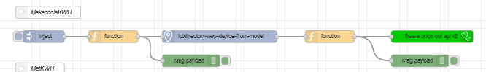
Initialization of Devices
Final flow delivering the data to the dashboard widgets
Logical Flow (Business Flow)

Slide 21
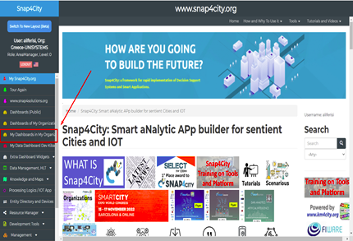
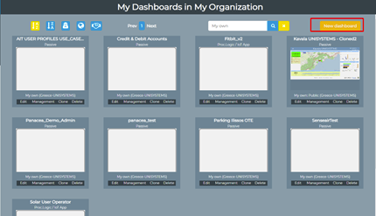
Dashboard Builder
Choose the option My dashboards in My Organization
Dashboard Builder
Press “New Dashboard”

Slide 22
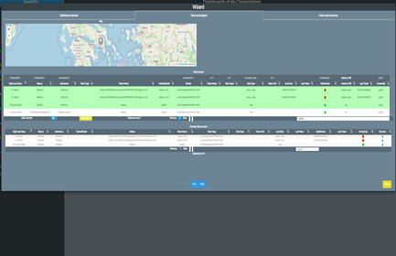
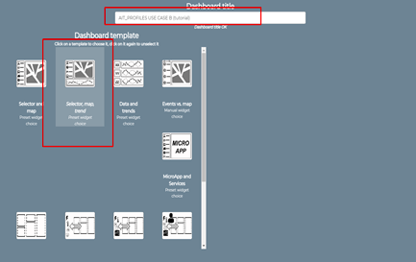
Dashboard Builder
Choose Dashboard Template & Entry Title
Dashboard Builder
Search Entity of instances via Data Inspector

Slide 23
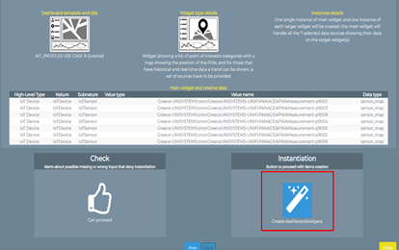
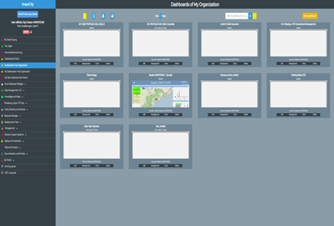
Dashboard Builder
Instantiation of selected instance entities
Dashboard Builder
Automatic creation of a dashboard with related widgets

Slide 24
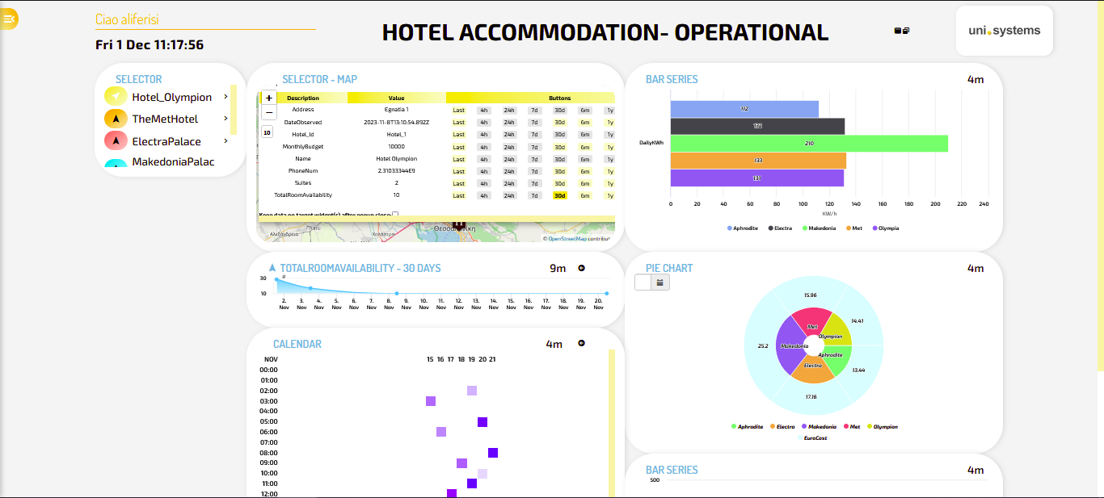
User Interface - Dashboard
https://www.snap4city.org/dashboardSmartCity/view/Baloon.php?iddasboard=NDAzOA==

Slide 25
Results
Optimize Hotel Operations
Real-time monitoring enhances performance and minimizing downtime.
Final Results
Reduce Unnecessary Expenses
Resource allocation optimization and data-driven decision-making, resulting in substantial savings.
Improve Customer Satisfaction
Quick issue resolution and an improved accommodation experience, leading to increased user happiness and loyalty

Slide 26
Future Developments
Real-time Weather Updates
Future Developments
Code/Flow Improvements
Additional Hotel Information and Management Through Widgets

Slide 27
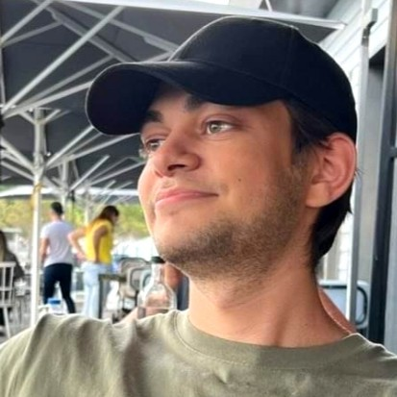
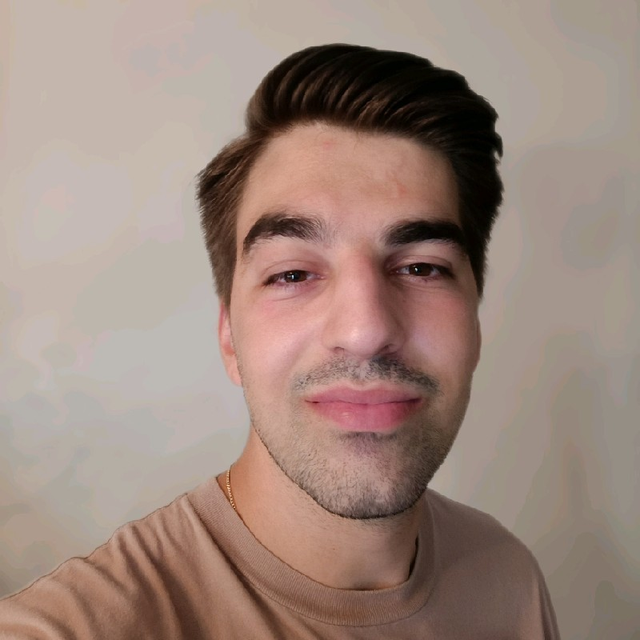
Practicum Key Learnings & Future Goals
Filippos Symeonidis
Vagelis Chasiotis
Key Learnings:
Gained familiarity with business logic
Better understanding of the inner workings of a company
Understood the basic phases in application development
Future Goals:
Information Security
Key Learnings:
Understand the basic phases in application development
Team Collaboration
Skill Expansion
Future Goals
Mobile App Development and Design

Slide 28





Thank you for your attention!
Uni Systems
UniSystems_GR
Uni Systems
info@unisystems.com
unisystems.com
Uni Systems Copyright © 2023

